Slide 1
Functions

Slide 2
Introduction
During the 1970s and into the 80s, the primary software engineering methodology was structured programming.
Structured programming makes
Programs more comprehensible.
Programming errors less frequent.
A function is a self-contained block of program statements that performs a particular task.

Slide 3
Why are Functions Needed?
It breaks up a program into easily manageable chunks and makes programs significantly easier to understand.
Well written functions may be reused in multiple programs. eg. The C standard library functions.
Functions can be used to protect data.
Different programmers working on one large project can divide the workload by writing different functions.

Slide 4
Why are Functions Needed?
All C programs contain at least one function, called main() where execution starts.
When a function is called, the code contained in that function is executed.
When the function has finished executing, control returns to the point at which that function was called.

Slide 5
Function declaration an definition
A function declaration tells the compiler about a function's name, return type, and parameters.
A function definition provides the actual body of the function.

Slide 6
Function Prototype Declaration
The general form of function declaration statement is as follows:
return_data_type function_name (data_type variable1,...);
Or
return_data_type function_name (data_type_list);

Slide 7
Function Prototype Declaration
return_data_type function_name (data_type variable1,...);
function_name :
This is the name given to the function
it follows the same naming rules as that for any valid variable in C.
return_data_type:
This specifies the type of data given back to the calling construct by the function after it executes its specific task.
data_type_list(parameters):
This list specifies the data type of each of the variables.

Slide 8
Function Example
/* function returning the max between two numbers */
int max(int num1, int num2)
{ /* local variable declaration */
int result;
if (num1 > num2)
result = num1;
else result = num2;
return result;
}

Slide 9
Main
#include <stdio.h>
/* function declaration */
int max(int num1, int num2);
int main ()
{ /* local variable definition */
int a = 100;
int b = 200;
int ret;
/* calling a function to get max value */
ret = max(a, b);
printf( "Max value is : %d\n", ret );
return 0; }
/* function body*/
int max(int num1, int num2)
{ /* local variable declaration */
int result;
if (num1 > num2)
result = num1;
else
result = num2;
return result; }
Function Body

Slide 10
Actual and Formal parameters
Actual Parameters or Arguments:
When a function is called, the values (expressions) that are passed in the call are called the arguments or actual parameters.
At the time of the call each actual parameter is assigned to the corresponding formal parameter in the function definition.
Parameter Written In Function Call is Called “Actual Parameter”
Parameter Written In Function Definition is Called “Formal Parameter”
Formal parameters behave like other local variables inside the function and are created upon entry into the function and destroyed upon exit.
int main ()
{
..
ret = max(a, b);
printf( "Max value is : %d\n", ret );
}
int max(int num1, int num2)
{ ….
return result; }

Slide 11
Function Prototype Declaration
The name of a function is global.
No function can be defined in another function body.
Number of arguments must agree with the number of parameters specified in the prototype.
The function return type cannot be an array or a function type.

Slide 12
Rules for Parameters
The number of parameters in the actual and formal parameter lists must be consistent.
Parameter association in C is positional.
Actual parameters and formal parameters must be of compatible data types.
Actual (input) parameters may be a variable, constant, or any expression matching the type of the corresponding formal parameter.

Slide 13
Calling a function
While calling a function, there are two ways in which arguments can be passed to a function −
S.N. | Call Type & Description
1 | Call by value This method copies the actual value of an argument into the formal parameter of the function. In this case, changes made to the parameter inside the function have no effect on the argument.
2 | Call by reference This method copies the address of an argument into the formal parameter. Inside the function, the address is used to access the actual argument used in the call. This means that changes made to the parameter affect the argument.

Slide 14
Call by Value Mechanism
In call by value, a copy of the data is made and the copy is sent to the function.
The copies of the value held by the arguments are passed by the function call.
As only copies of the values held in the arguments are sent to the formal parameters, the function cannot directly modify the arguments passed.

Slide 15
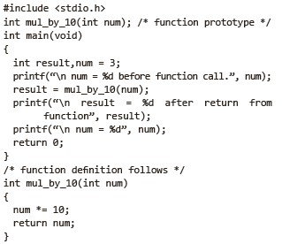

An Example of Call by value Mechanism:

Slide 16
Function Example : Factorial
#include <stdio.h>
long factorial(int);
int main()
{ int number;
long fact = 1;
printf("Enter a number to calculate it's factorial\n"); scanf("%d", &number);
printf("%d! = %ld\n", number, factorial(number));
return 0;
}
long factorial(int n)
{
int c;
long result = 1;
for (c = 1; c <= n; c++)
result = result * c;
return result;
}
n! = n*(n-1)*(n-2)*(n-3)...3.2.1 and zero factorial is defined as one i.e. 0! = 1.

Slide 17
WAP to swap the values of two variables by using a suitable user defined function (say SWAP) for it.

Slide 18
WAP to swap the values of two variables by using a suitable user defined function (say SWAP) for it.
void swap(int, int);
int main()
{
int a, b;
printf("Enter values for a and b\n");
scanf("%d%d", &a, &b);
printf("\n\nBefore swapping: a = %d and b = %d\n", a, b);
swap(a, b);
return 0;
}
void swap(int x, int y)
{
int temp;
temp = x;
x = y;
y = temp;
printf("\nAfter swapping: a = %d and b = %d\n", x, y);
}

Slide 19
Find out the value of nth term of the Fibonacci sequence

Slide 20
PROGRAM CODE
#include<stdio.h>
int fib(int);
int main()
{
int n;
printf("\nEnter term number :");
scanf("%d",&n);
printf("\nThe value of the term-%d of Fibonacci sequence is %d.”, n, fib(n));
return 0;
}
/*User defined iterative function
fib that returns the value of ith
term of Fibonacci sequence*/
int fib(int n)
{
int i,f1=0,f2=1,f;
if (n==0 || n==1)
return (n-1);
Find out the value of nth term of the Fibonacci sequence
else
{
for(i=1; i<=n-2; i++)
{
f=f1+f2;
f1=f2;
f2=f;
}
return f;
}
}

Slide 21
INPUT/OUTPUT
RUN-1
Enter term number: 6
The value of the term-6 of Fibonacci sequence is 8.
RUN-2
Enter term number: 15
The value of the term-5 of Fibonacci sequence is 377.

Slide 22
Palindrome

Slide 23
Palindrome
#include <stdio.h>
int main() {
int n, reversed = 0, remainder, original;
printf("Enter an integer: ");
scanf("%d", &n);
original = n;
// reversed integer is stored in reversed variable
while (n != 0) {
remainder = n % 10;
reversed = reversed * 10 + remainder;
n /= 10;
}
// palindrome if orignal and reversed are equal
if (original == reversed)
printf("%d is a palindrome.", original);
else
printf("%d is not a palindrome.", original);
return 0;
}

Slide 24
Passing Arrays to Functions
When an array is passed to a function, the address of the array is passed and not the copy of the complete array.
During its execution the function has the ability to modify the contents of the array that is specified as the function argument.
The array is not passed to a function by value.
This is an exception to the rule of passing the function arguments by value.

Slide 25
calculate the sum of all the integers stored in the array.
#include<stdio.h>
int SUM-ARRAY(int a[],int);
//Function Prototype
int main()
{
int a[100], n, i;
printf("\nEnter how many numbers :");
scanf("%d",&n);
printf("\nEnter data for array: ");
for(i=0;i<n;i++)
scanf("%d",&a[i]);
printf(“\nThe sum of the elements of the array is %d”, SUM-ARRAY(a, n);
return 0;
}
/*User Defined Function
SUM-ARRAY*/
int SUM-ARRAY(int a[], int n)
{
int i, sum=0;
for(i=0; i<n; i++)
{
sum=sum + a[i];
}
return sum;
}

Slide 26
INPUT/OUTPUT
RUN-1
Enter how many numbers : 4
Enter data for array: 7 6 5 4
The sum of the elements of the array is 22
RUN-2
Enter how many numbers : 5
Enter data for array: 1 2 3 4 5
The sum of the elements of the array is 15

Slide 27
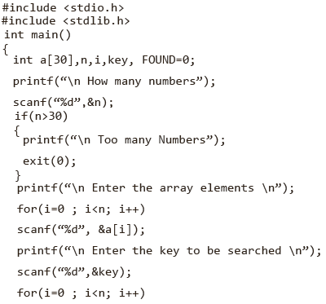
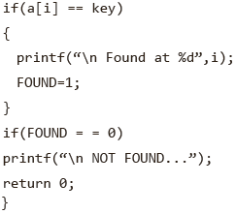
Searching an element within an array
For loop

Slide 28
Search an element within array using function
#include<stdio.h>
int linear_search(int A[], int, int);
main()
{
int array[100], search, c, n, position;
printf("Enter the number of elements in array\n");
scanf("%d",&n);
printf("Enter %d numbers\n", n);
for ( c = 0 ; c < n ; c++ )
scanf("%d",&array[c]);
printf("Enter the number to search\n");
scanf("%d",&search);
position = linear_search(array, n, search);
if ( position == -1 )
printf("%d is not present in array.\n", search);
else
printf("%d is present at location %d.\n", search, position+1);
return 0;
}
int linear_search(int A[], int n, int find)
{
int c;
for ( c = 0 ; c <= n ; c++ )
{
if ( A[c] == find )
return c;
}
return -1;
}

Slide 29
#include<stdio.h>
void bubbleSort(int a[],int);
int main()
{
int a[100], n, i;
printf("\nEnter how
many numbers :");
scanf("%d",&n);
printf("\nEnter data for array: ");
for(i=0;i<n;i++)
scanf("%d",&a[i]);
bubbleSort(a,n); //Function Call
printf(“\nThe Numbers in
ascending order are:”);
for(i=0; i<n; i++)
printf("%d ",a[i]);
return 0;
}
sort the elements of an array in ascending order by calling a sort function
/*Bubble Sort Function*/
void bubbleSort(int a[], int n)
{
int i, j, temp;
for(i=1; i<=n-1; i++)
{
for(j=0; j<n-i; j++)
{
if(a[j]>a[j+1])
{
temp=a[j];
a[j]=a[j+1];
a[j+1]=temp;
}
}
}
}

Slide 30
INPUT/OUTPUT
RUN-1
Enter how many numbers :8
Enter data for array: 7 6 5 4 5 2 4 8
The Numbers in ascending order are: 2 4 4 5 5 6 7 8
RUN-2
Enter how many numbers :9
Enter data for array: 1 4 3 8 6 5 2 9 7
The Numbers in ascending order are: 1 2 3 4 5 6 7 8 9

Slide 31
PROGRAM CODE
#include <stdio.h>
int gcd(int,int);
int main()
{
int a,b,g;
printf(“\nEnter two numbers=>”);
scanf(“%d%d”,&a, &b);
printf(“\nThe GCD of %d and %d is %d\n”,a, b, gcd(a,b));
return 0;
}
calculate GCD/HCF of two numbers by using a iterative function for GCD.
/*GCD Iterative Function*/
int gcd(int a, int b)
{
int t;
while(b!=0)
{ t=b;
b=a%b;
a=t;
}
return (a);
}

Slide 32
INPUT/OUTPUT
RUN-1
Enter two numbers=>15 25
The GCD of 15 and 25 is 5
RUN-2
Enter two numbers=>22 14
The GCD of 22 and 14 is 2

Slide 33
How to check if a given number is Fibonacci number?

Slide 34
A simple way is to generate Fibonacci numbers until the generated number is greater than or equal to ‘n’. Following is an interesting property about Fibonacci numbers that can also be used to check if a given number is Fibonacci or not.
A number is Fibonacci if and only if one or both of (5*n^2 + 4) or (5*n^2 – 4) is a perfect square .

Slide 35
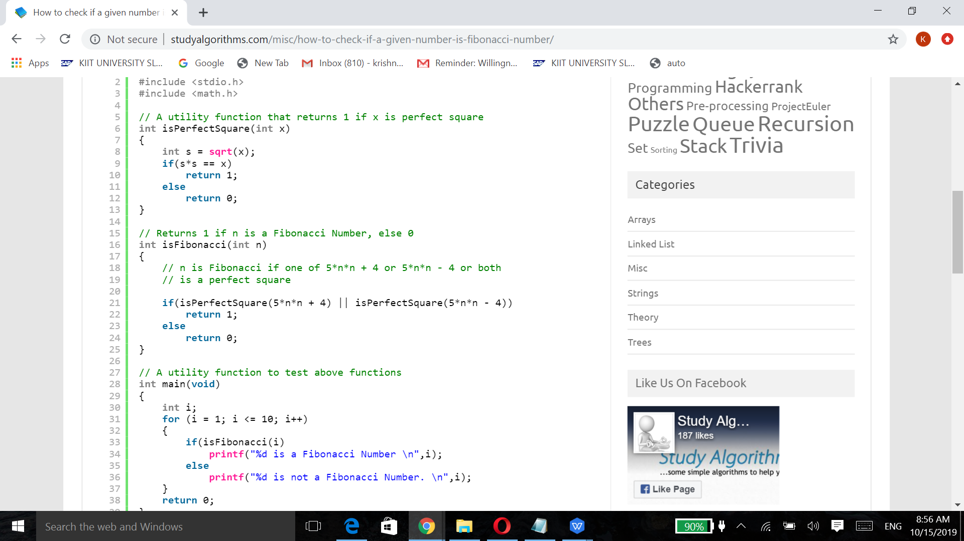
You can simply take i as input, no need for loop

Slide 36
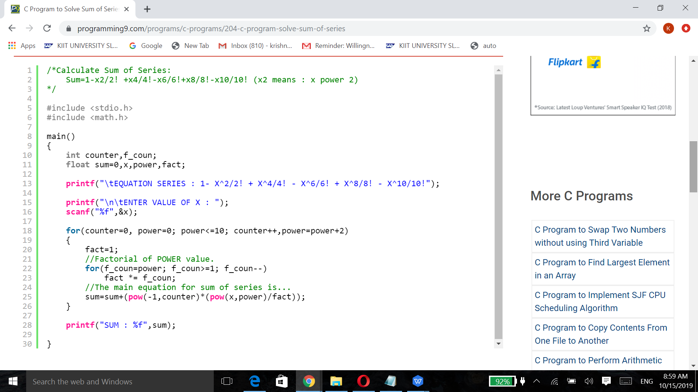

Slide 37
Scope Rules
scope in any programming is a region of the program where a defined variable can have its existence and beyond that variable it cannot be accessed. There are three places where variables can be declared in C programming language −
Inside a function or a block which is called local variables.
Outside of all functions which is called global variables.
In the definition of function parameters which are called formal parameters.

Slide 38
Example of local variables
#include <stdio.h>
int main ()
{
/* local variable declaration , local to main*/
int a, b;
int c;
/* actual initialization */
a = 10;
b = 20;
c = a + b;
printf ("value of a = %d, b = %d and c = %d\n", a, b, c);
return 0;
}
Variables that are declared inside a function or block are called local variables.
They can be used only by statements that are inside that function or block of code.

Slide 39
Example of global variables
#include <stdio.h>
/* global variable declaration */
int g;
int main ()
{
/* local variable declaration */
int a, b;
/* actual initialization */
a = 10;
b = 20;
g = a + b;
printf ("value of a = %d, b = %d and g = %d\n", a, b, g);
return 0;
}
Global variables are defined outside a function, usually on top of the program.
Global variables hold their values throughout the lifetime of your program and they can be accessed inside any of the functions defined for the program.

Slide 40
Local and global variables
Precedence
#include <stdio.h>
/* global variable declaration */
int g = 20;
int main ()
{
/* local variable declaration */
int g = 10;
printf ("value of g = %d\n", g);
return 0;
}
OUTPUT
value of g = 10
A program can have same name for local and global variables but the value of local variable inside a function will take preference.

Slide 41
Formal Parameters
#include <stdio.h>
/* global variable declaration */
int a = 20;
int main ()
{ /* local variable declaration in main function */
int a = 10;
int b = 20;
int c = 0;
printf ("value of a in main() = %d\n", a);
c = sum( a, b);
printf ("value of c in main() = %d\n", c);
return 0;
}
/* function to add two integers */
int sum(int a, int b)
{ printf ("value of a in sum() = %d\n", a);
printf ("value of b in sum() = %d\n", b);
return a + b;
}
value of a in main() = 10
value of a in sum() = 10
value of b in sum() = 20
value of c in main() = 30
Formal parameters, are treated as local variables with-in a function and they take precedence over global variables.

Slide 42
Initializing Local and Global Variables
When a local variable is defined, it is not initialized by the system, you must initialize it yourself.
Global variables are initialized automatically by the system when you define them as follows −
Data Type | Initial Default Value
int | 0
char | '\0'
float | 0
double | 0

Slide 43
Scope Rules
The region of the program over which the declaration of an identifier is accessible is called the scope of the identifier.
The scope relates to the accessibility, the period of existence, and the boundary of usage of variables declared in a program.
Scopes can be of four types.
Block
File
Function
Function prototype

Slide 44
Storage Classes

Slide 45
Storage Class Specifiers for Functions
The only storage class specifiers that may be assigned with functions are extern and static.
The extern signifies that the function can be referenced from other files.
The static signifies that the function cannot be referenced from other files.
If no storage class appears in a function definition, extern is presumed.

Slide 46
Recursion
Recursion in programming is a technique for defining a problem in terms of one or more smaller versions of the same problem.
A function that calls itself directly or indirectly to solve a smaller version of its task until a final call which does not require a self-call is a recursive function.
The following are necessary for implementing recursion:
Decomposition into smaller problems of same type.
Recursive calls must diminish problem size.
Necessity of base case.
Base case must be reached.

Slide 47
int main()
{
recursion();
}
void recursion()
{
recursion(); /* function calls itself */
}
But while using recursion, programmers need to be careful to define an exit condition from the function, otherwise it will go into an infinite loop.

Slide 48
what is a base class ?
An instance of a problem which requires no further recursive calls.
The recursive algorithm
If (this is a base class)
Solve it directly
Else
Redefine the problem using recursion.

Slide 49
#include<stdio.h>
int fib(int);
int main()
{
int n;
printf("\nEnter term number :");
scanf("%d",&n);
printf("\nThe value of the term-%d of
Fibonacci sequence is %d.”, n, fib(n));
return 0;
}
/*Recursive version
of the
Fibonacci function to
compute the ith term*/
int fib(int i)
{
if(i==0 || i==1)
return (i);
else
return (fib(i-1)+ fib(i-2));
}
Find nth term in
Fibonacci series
0, 1, 1, 2, 3, 5, 8, 13, 21, 34, ...
fib(4)
= fib(3) + fib(2)
= (fib(2) + fib(1)) + (fib(1) + fib(0))
= (fib(2) + 1 ) + ( 1 + 0 )
= (fib(2) + 2)
= ((fib(1) + fib(0)) + 2
= 1 + 0 + 2
= 3

Slide 50
INPUT/OUTPUT
RUN-1
Enter term number: 6
The value of the term-6 of Fibonacci sequence is 8.
RUN-2
Enter term number: 15
The value of the term-5 of Fibonacci sequence is 377.

Slide 51
What is needed for implementing recursion?
Decomposition into smaller problems of same type
Recursive calls must diminish problem size
Necessity of base case
Base case must be reached
It acts as a terminating condition. Without an explicitly defined base case, a recursive function would call itself indefinitely.
It is the building block to the complete solution. In a sense, a recursive function determines its solution from the base case(s) it reaches.

Slide 52
#include <stdio.h>
int sum(int n);
int main()
{
int number, result;
printf("Enter a positive integer: ");
scanf("%d", &number);
result = sum(number);
printf("sum=%d", result);
}
int sum(int num)
{
if (num!=0)
return num + sum(num-1); // sum() function calls itself
else
return num;
}
Sum of Natural Numbers Using Recursion
RUN
Enter a positive integer:
3
6

Slide 53
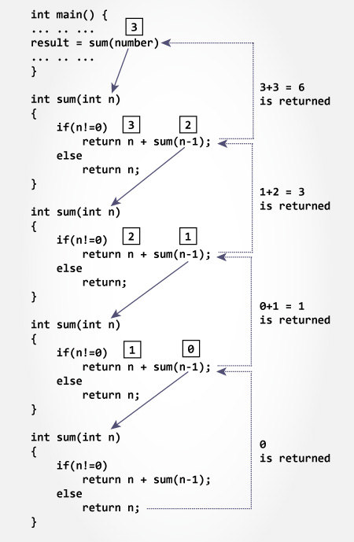

Slide 54
/
#include <stdio.h>
int factorial(unsigned int i)
{
if(i <= 1)
{
return 1;
}
return i * factorial(i - 1);
}
int main()
{
int i = 15;
printf("Factorial of %d is %d\n", i, factorial(i));
return 0;
}
factorial

Slide 55
PROGRAM CODE
#include <stdio.h>
int gcd(int,int);
int main()
{
int a,b,g;
printf(“\nEnter two numbers=>”);
scanf(“%d%d”,&a, &b);
printf(“\nThe GCD of %d and %d is %d\n”,a, b, gcd(a,b));
return 0;
}
calculate GCD/HCF of two numbers by using a iterative function for GCD.
/*GCD Iterative Function*/
int gcd(int a, int b)
{
int t;
while(b!=0)
{ t=b;
b=a%b;
a=t;
}
return (a);
}

Slide 56
#include <stdio.h>
int hcf(int n1, int n2);
int main()
{
int n1, n2;
printf("Enter two positive integers: ");
scanf("%d %d", &n1, &n2);
printf("G.C.D of %d and %d is %d.", n1, n2, hcf(n1,n2)); return 0;
}
int hcf(int n1, int n2)
{
if (n2 != 0)
return hcf(n2, n1%n2);
else
return n1;
}
GCD of Two Numbers using Recursion
RUN
Enter two positive integers:
366
60
G.C.D of 366 and 60 is 6.

Slide 57
include <stdio.h>
//function to count digits
int countDigits(int num)
{
static int count=0;
if(num>0)
{
count++;
countDigits(num/10);
}
else
{
return count;
}
}
int main()
{
int number;
int count=0;
printf("Enter a positive integer number: ");
scanf("%d",&number);
count=countDigits(number);
printf("Total digits in number %d is: %d\n",number,count);
return 0;
}
Count digits of a number program using recursion.
RUN
Enter a positive integer number:
123
Total digits in number 123 is: 3

Slide 58
Print Sum of Even Numbers in Array using Recursion
#include<stdio.h>
void SumOfEven(int a[],int num,int sum);
main()
{
int i,a[100],num,sum=0;
printf("Enter number of Array Elements\n");
scanf("%d",&num);
printf("Enter Array Elements\n");
for(i=0;i<num;i++)
{
scanf("%d",&a[i]);
}
SumOfEven(a,num-1,sum);
}
void SumOfEven(int a[],int num,int sum)
{
if(num>=0)
{
if((a[num])%2==0)
{
sum+=(a[num]);
}
SumOfEven(a,num-1,sum);
}
else
{
printf("Sum=%d\n",sum);
return;
}
}

Slide 59
Searching
Among the searching algorithms, only two of them will be discussed here;
Sequential search
Binary search.

Slide 60
Sequential Search
Here is an implementation of this simple algorithm:
int Lsearch(int ArrayElement[], int key, int ArraySize)
{
int i ;
for (i = 0; i < ArraySize; i++)
if (ArrayElement[i] == Key)
return (i) ;
return (-1);
}

Slide 61
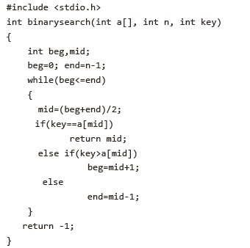
Binary Search
The C code for binary search is given below.

Slide 62
#include<stdio.h>
void bubbleSort(int a[],int);
int main()
{
int a[100], n, i;
printf("\nEnter how many numbers :");
scanf("%d",&n);
printf("\nEnter data for array: ");
for(i=0;i<n;i++)
scanf("%d",&a[i]);
bubbleSort(a,n); //Function Call
printf(“\nThe Numbers in ascending order are:”);
for(i=0; i<n; i++)
printf("%d ",a[i]);
return 0
}
Sort an array using a suitable function for sort operation.

Slide 63
/*Bubble Sort Function*/
void bubbleSort(int a[], int n)
{
int i, j, temp;
for(i=1; i<=n-1; i++)
{
for(j=0; j<n-i; j++)
{
if(a[j]>a[j+1])
{
temp=a[j];
a[j]=a[j+1];
a[j+1]=temp;
}
}
}
}
INPUT/OUTPUT
RUN-1
Enter how many numbers :8
Enter data for array: 7 6 5 4 5 2 4 8
The Numbers in ascending order are: 2 4 4 5 5 6 7 8
RUN-2
Enter how many numbers :9
Enter data for array: 1 4 3 8 6 5 2 9 7
The Numbers in ascending order are: 1 2 3 4 5 6 7 8 9

